Slide 1

Session 2: Size and surface related phenomena
February 7, 2020

Slide 2
Session Objectives
Recap:
Scale of things
Words associated to Nano
List of Fabrication Methods
General properties
Surface phenomena

Slide 4
Applications of Nanotechnology

Slide 8
Calculate
Calculate the total surface when you divide a cube with an 1 cm edge:
8 smaller cubes.
16 smaller cubes.
32 smaller cubes.
64 smaller cubes.
128 smaller cubes.
256 smaller cubes.
512 smaller cubes.
How important is this?

Slide 9
Calculate
How many iron atoms can be inside a cube with a 30 nm, 10 and 3nm edge?
How many iron atoms are on the surface of each cube?

Slide 10
Nano-Scale & Conventional Polymeric Size
Type | Size
Polymer latex size | 50-500 nm
Hiding grade TiO₂ | 200-250 nm
Polyurethane dispersion particle size | 50-100 nm
Polymer molecular size in solution | 2-100 nm

Slide 11
Surface Area
Volume= 4/3 π r³
Surface area= 4 π r²
If the density of TiO2 is 4 grs/cm³, and
What is the
What is the
What is the
If the particle diameter is: | # particles per gram? | Surface area per gram? | Surface area per volume?
200 | 6x10¹³ | 7.5 | 1.8x10¹²
20 | 6x10¹⁶ | 75 | 1.8x10¹⁶
2 | 6x10¹⁹ | 750 | 1.8x10²⁰

Slide 12
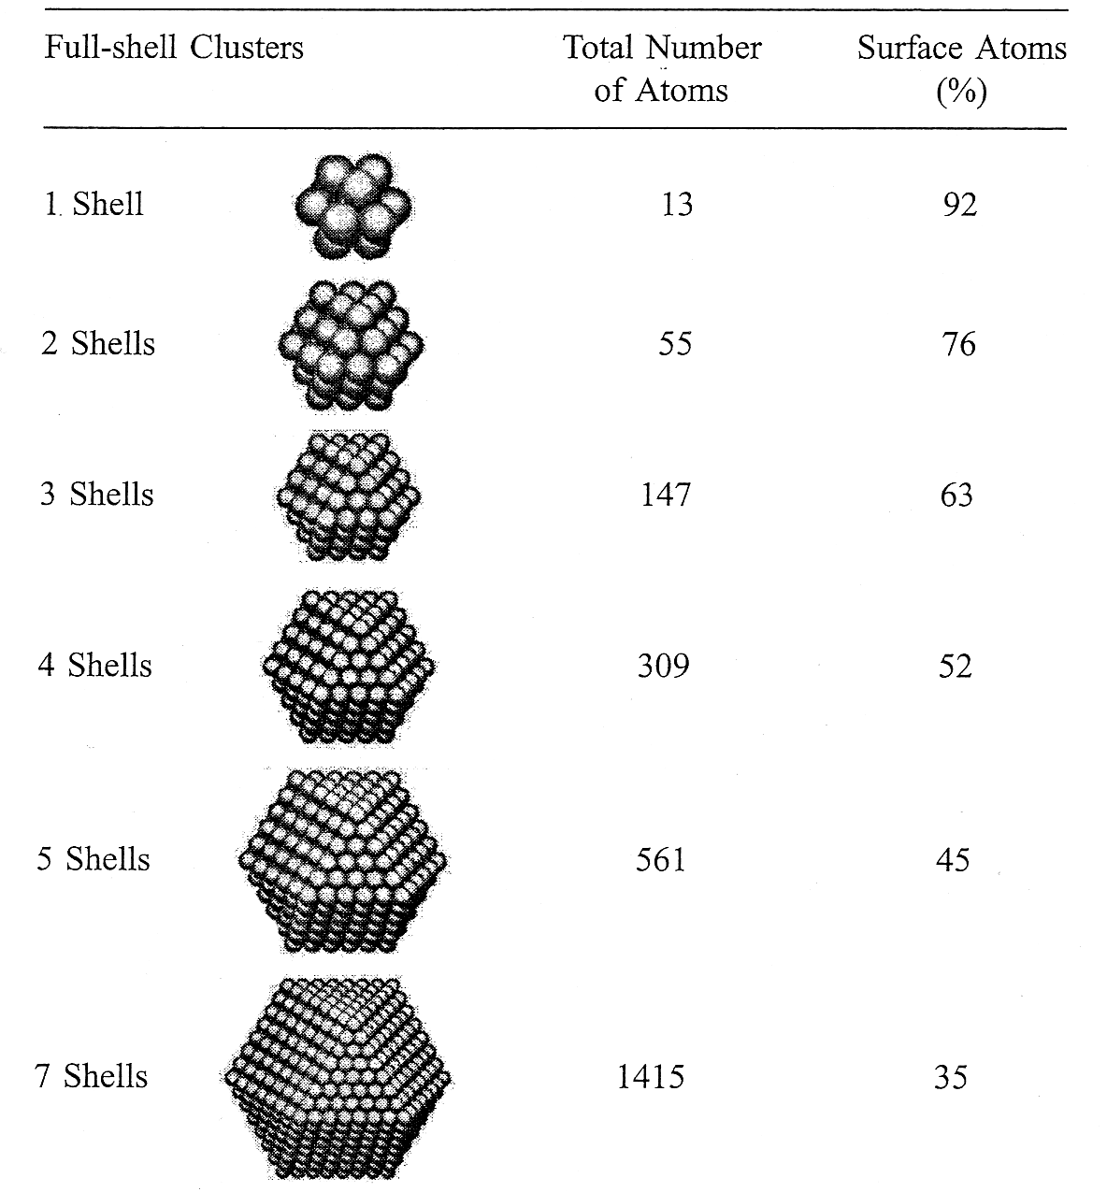
Percentage of Surface Atoms

Slide 13
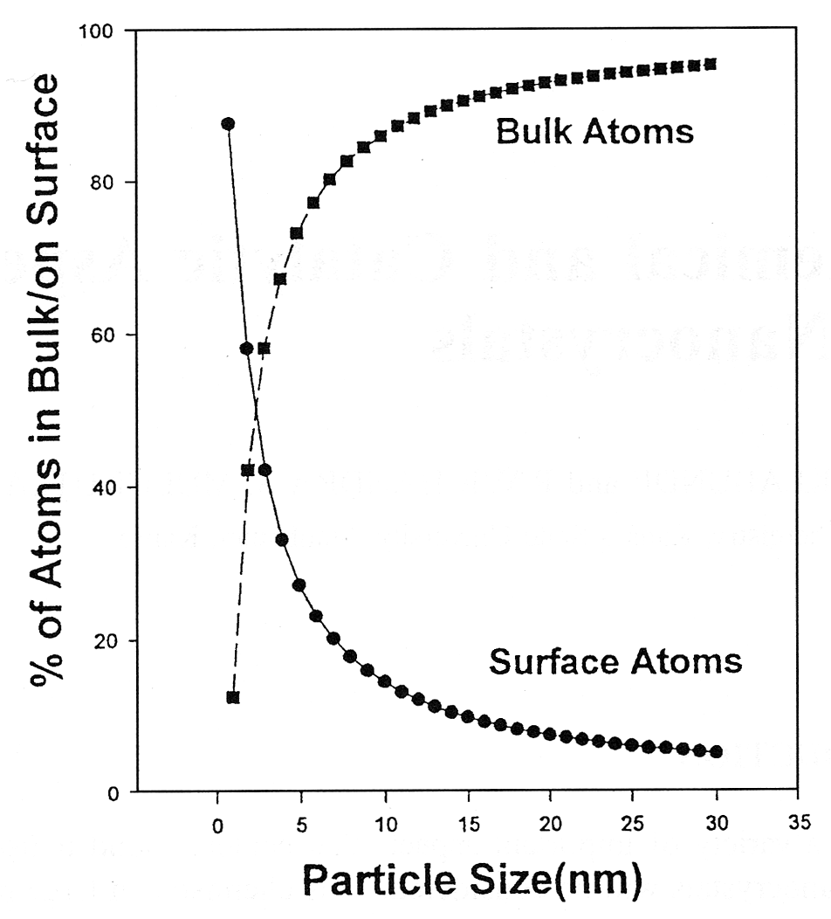
Surface to Bulk Atoms Ratio
• Spherical iron nanocrystals
• J. Phys. Chem. 1996, Vol. 100, p. 12142

Slide 14

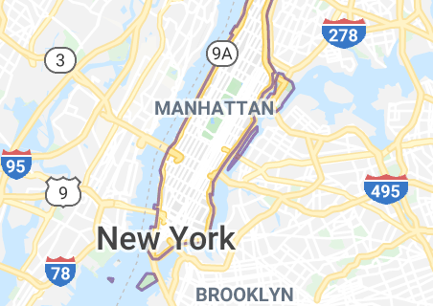
Surface Area Dependence on Size
By the way… the surface area of our lungs is approximately 70-100m²
59,1 km²
The surface area of spherical nanoparticles of 150 nm in 1m³ is approximately equivalent to
150

Slide 15
Surface Material Content
A particle of 10 nm diameter has 20% of its atoms on the surface
A particle of 2 nm diameter has 80% of its atoms on the surface
A particle of 1 nm diameter has 80% of its atoms on the surface

Slide 17
Fabrication Methods

Slide 20
Fabrication
Nanofabrication techniques
Molecular self assembly
Colloid monolayer lithography
Electron beam lithography
Focused ion beam lithography
Electrically induced nanopatterning
X-ray lithography
Ion projection lithography
Rapid prototyping
direct deposition,
three-dimensional printing,
selective laser sintering,
laser stereolithography,
evaporation-induced self assembly,
pen lithography,
ink-jet printing and
dip-coating techniques
Microfabrication techniques:
Photolithography
Soft lithography
Film deposition
Etching
Bonding

Slide 21
Nano Particles Dimensions
Zero Dimension: Nano partricles, nano dots
One Dimension: Nano wire
Two Dimension: Nano films

Slide 22
Some Fabrication Process for Nanomaterials
Nanoparticles (0D):
colloidal processing,
flame combustion,
phase segregation.
Nanorods or nanowires (1D):
template-based electroplating,
vapor-liquid-solid growth (VLS),
spontaneous anisotropic growth.
Thin films (2D):
molecular beam epitaxy (MBE)
atomic layer deposition (ALD)
Nanostructured bulk materials :
self-assembly of nano sized particles for photonic band gap crystals.

Slide 23
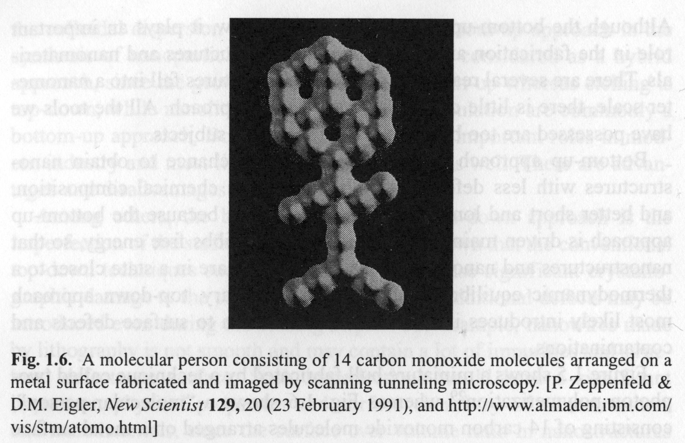
Nanofabrication techniques

Slide 24
Properties
Mechanical
Electrical
Physical
Optical
Thermal
Chemical
Quantum

Slide 25
Some physical properties affected by size
Nanomaterials exhibits remarkable different characteristics from their bulk form:
Melting point decreases as size of Au nanoparticles reduce.
Energy gap of Si nanoparticles is larger than that of bulk Si (1.12 eV).
Eg of Si materials
Melting point of Au nanoparticles
diameter
Tm
diameter
Eg
bulk
1,064°C
bulk
1.12 eV
20 nm
～990℃
10 nm
～1.20 eV
5 nm
～850℃
7 nm
～1.29 eV
4 nm
～750℃
5 nm
～1.62 eV
2 nm
～330℃
3 nm
～2.60 eV

Slide 26
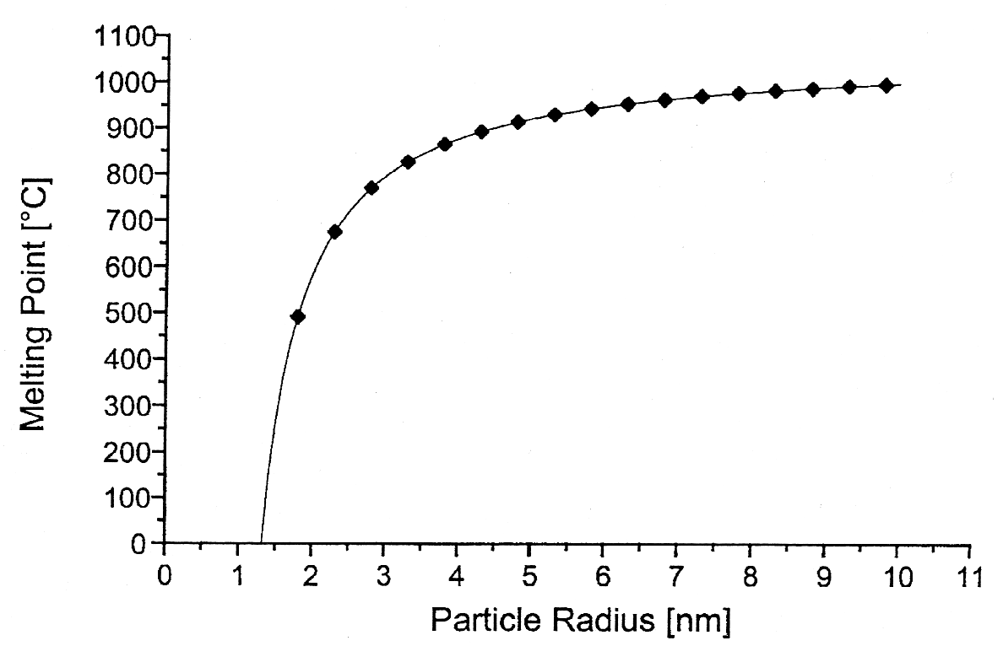
Thermal: melting point
Why ?
Penomenon?
The melting point decreases dramatically as the particle size gets below 5 nm
Source: Nanoscale Materials in Chemistry, Wiley, 2001

Slide 27
Melting Point Dependence on Particle Size
• Lowering of the melting point is proportional to 1/r
• ΔT can be as large as couple of hundred degrees when the particle size gets below 10 nm
• Most of the time, the surface tension coefficient (σ) is unknown; by measuring the melting point as a function of radius, σ can be estimated.
Note:
For nanoparticles embedded in a matrix, melting point may be lower or higher, depending on the strength of the interaction between the particle and matrix.

Slide 28
Bulk vs. Surface Properties

Slide 29
Challenges in Nanotechnology
Overcome the huge surface energy, a result of enormous surface area or large surface to volume ratio.
Ensure all nanomaterials with desired size, uniform size distribution, morphology, crystallinity, chemical composition, and microstructure, that all together result in desired physical properties.
Prevent nanomaterials and nanostructures from coarsening through either Ostwald ripening or agglomeration as time evolutes.

Slide 30
Recess

Slide 31
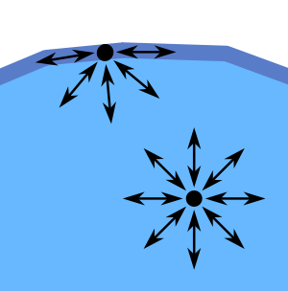
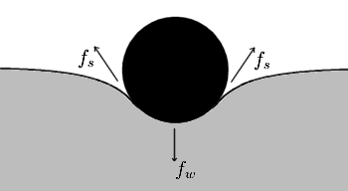
Surface Tension
http://en.wikipedia.org/wiki/Surface_tension

Slide 32
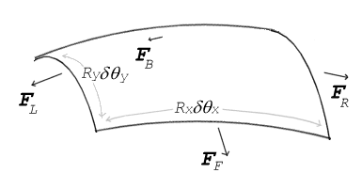
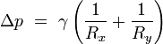
Young-Laplace equation
size.
Δp for water drops of different radii at STP
Droplet radius | 1 mm | 0.1 mm | 1 μm | 10 nm
Δp (atm) | 0.0014 | 0.0144 | 1.436 | 143.6

Slide 33
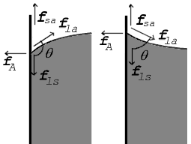
Solid Wall-Liquid Interactions
Forces at contact point shown for contact angle greater than 90° (left) and less than 90° (right)

Slide 34
Typically:
γ_{la} > γ_{ls} – γ_{sa} > 0

Slide 35
Liquid | Solid | Contact angle
water |  | 0°
ethanol
diethyl ether
carbon tetrachloride
glycerol
acetic acid
water | paraffin wax | 107°
 | silver | 90°
methyl iodide | soda-lime glass | 29°
 | lead glass | 30°
 | fused quartz | 33°
mercury | soda-lime glass | 140°
Some liquid-solid contact angles^{[5]}
soda-lime glass
lead glass
fused quartz

Slide 36
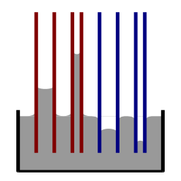
Measuring surface tension
h = (2 γ_{la} cos θ)/ (ρgr )
Illustration of capillary rise and fall. Red: contact angle less than 90°;
Blue=contact angle greater than 90°

Slide 37

What is the height of a “puddle”?

Slide 38
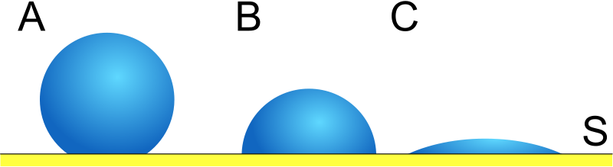
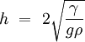
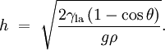
Illustration of how lower contact angle leads to reduction of puddle depth
For water on paraffin at 25ºC
For mercury on glass:

Slide 39
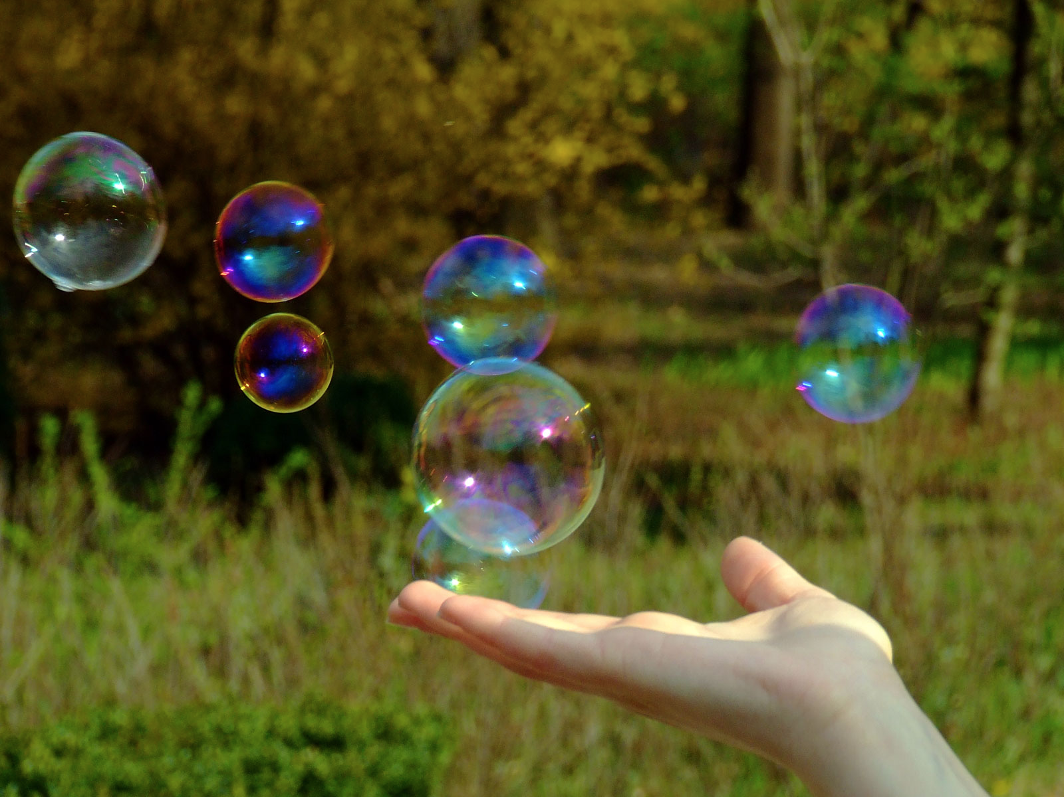
What is the pressure inside a bubble?

Slide 40
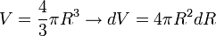
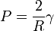
The pressure inside a soap bubble can be derived from thermodynamic free energy considerations. At constant temperature and particle number, dT = dN = 0, the differential Helmholtz free energy is given by
where P is the difference in pressure inside and outside of the bubble, and γ is the surface tension. In equilbrium, dF = 0, and so,
For a spherical bubble, the volume and surface area are given simply by
and
Substituting these relations into the previous expression, we find
which is equivalent to the Young-Laplace equation when Rx = Ry.

Slide 41
Surface tension of various liquids in dyn/cm against air. Mixture %'s are by weight; dyne/cm is also called mN/m in S.I. units
Liquid | Temperature °C | Surface tension, γ
Acetic acid | 20 | 27.6
Acetic acid (40.1%) + Water | 30 | 40.68
Acetic acid (10.0%) + Water | 30 | 54.56
Acetone | 20 | 23.7
Diethyl ether | 20 | 17
Ethanol | 20 | 22.27
Ethanol (40%) + Water | 25 | 29.63
Ethanol (11.1%) + Water | 25 | 46.03
Glycerol | 20 | 63
n-Hexane | 20 | 18.4
Hydrochloric acid 17.7M aqueous solution | 20 | 65.95
Isopropanol | 20 | 21.7
Mercury | 15 | 487
Methanol | 20 | 22.6
n-Octane | 20 | 21.8
Sodium chloride 6.0M aqueous solution | 20 | 82.55
Sucrose (55%) + water | 20 | 76.45
Water | 0 | 75.64
Water | 25 | 71.97
Water | 50 | 67.91
Water | 100 | 58.85

Slide 42
Video

